Slide 1
AcousticComms Spread Spectrum - Remote Sound Demo Instructions
Michael A. Ramalho, Ph.D.
November 2020
https://drive.google.com/drive/folders/1Q0QzIQt_9xE7GXbChYtEGaDAww0Qgg-X?usp=sharing

Slide 2
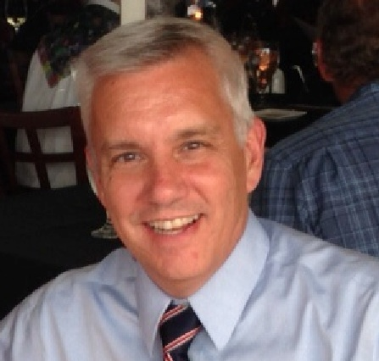
Education: Rutgers University: BSEE and PhD Cornell University: MEngEE Wharton Business School Executive Program (classwork) Udacity Artificial Intelligence Full Nanodegree (2018)
Employment: Bell Telephone Laboratories (Bell Labs) Bellcore/Telcordia Technologies
Voxware (Chief Telephony Technologist at IPO) Cisco Systems (networking, ultrasound, video, VoIP, sig proc, AI)
Noteworthy/Other: CSCO Proximity-v2 Inventor (Discrete Sequence Spread Spectrum)
Cisco Pioneer Award Finalist / Bellcore President’s Award
Patents: US: 50+ Issued / International: 20+ Issued Standards: ITU-T (G.711.0) & IETF RFCs (~5, IP Media & VoIP)
IMTC VoIP Forum Co-Chair Rutgers University Industrial Advisory Board and CAIP Fellow IEEE Comm Society Technical Program Vice Chair (Globecom)
IEEE Sig Processing and Communications Vice Chair (SW FL Section)
Red Shift Company Advisory Board (startup)
Cisco University Research Board / Cisco Patent Review Committee
Michael A Ramalho
ramalho.webhop.info mar42@cornell.edu

Slide 3
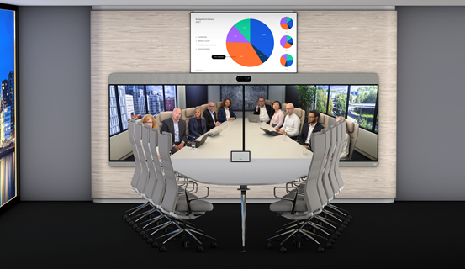
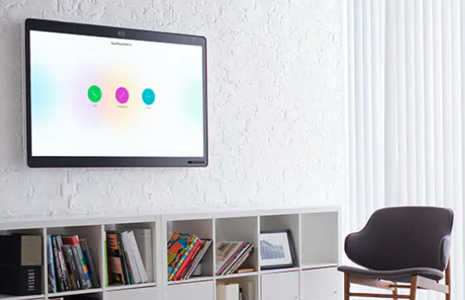

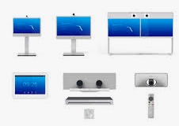
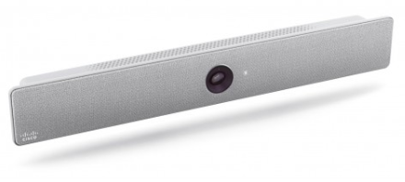
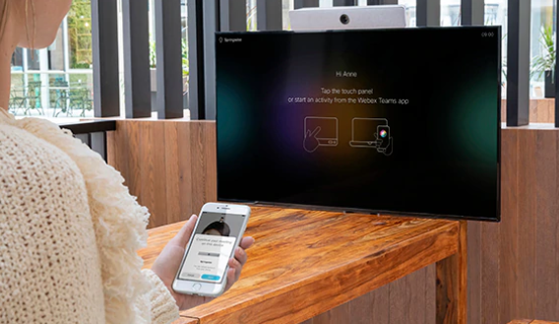
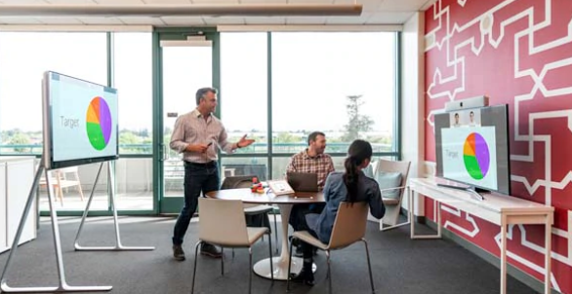
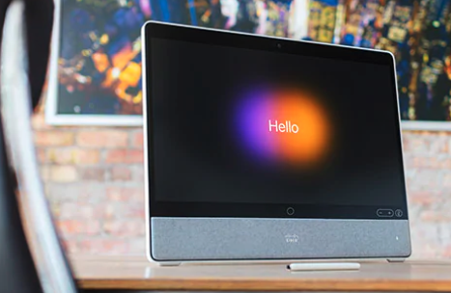
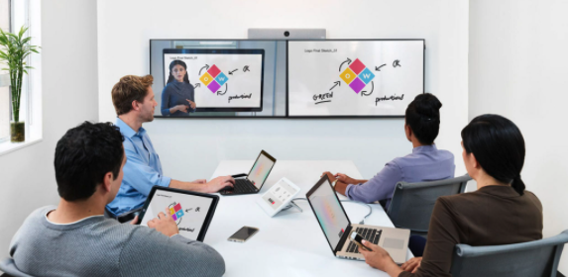
AcousticComms Spread Spectrum (ACSS)
Proven Base DSSS Design – Leveraged from Cisco US 10,003,377 Experience
[First of nine eventual patents filed – seven issued / two pending]
Tens of thousands of system endpoints (all Cisco cloud-connected Telepresence RoomOS endpoints)
Offices / Huddle Rooms (7’ x 7’) / Small Conf Rooms (7’ x 10’) to Large Conference rooms (40’ x 30’)
Pairing with hundreds of thousands of user endpoints (e.g., WebEx Teams on PCs/MacOS/iOS/Android)
Multi-million pairing-token reception events per day (native bit rate ~ 120 bps)
~100% reception of individual tokens (reported via Splunk metrics of “non-drive-by” pairings)
iPhone Android MacBook Air/Pro MSFT PCs
Images from www.cisco.com

Slide 4
AcousticComms Spread Spectrum Demo Goals
Demos to be performed/executed remotely ...
Using tools commonly used in acoustics experimentation ...
Providing independent assessment in ...
Customer-specific problematic acoustic settings.

Slide 5
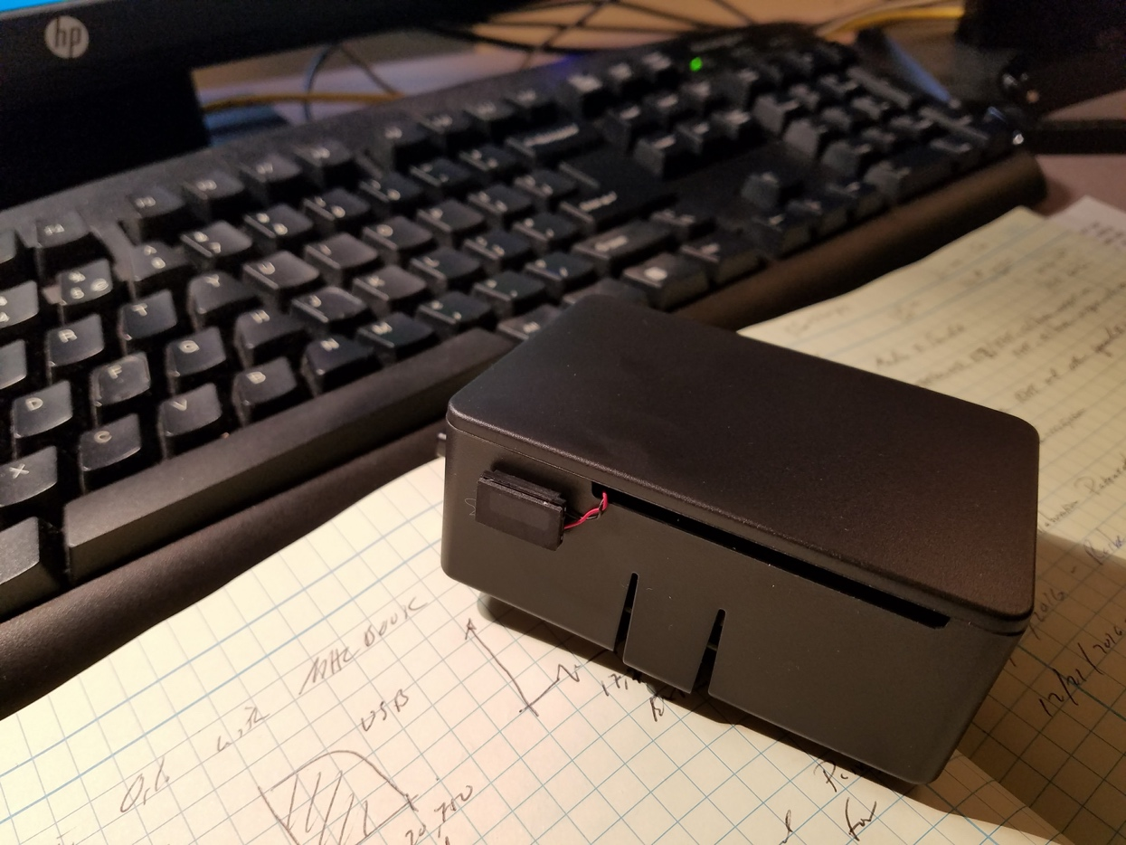
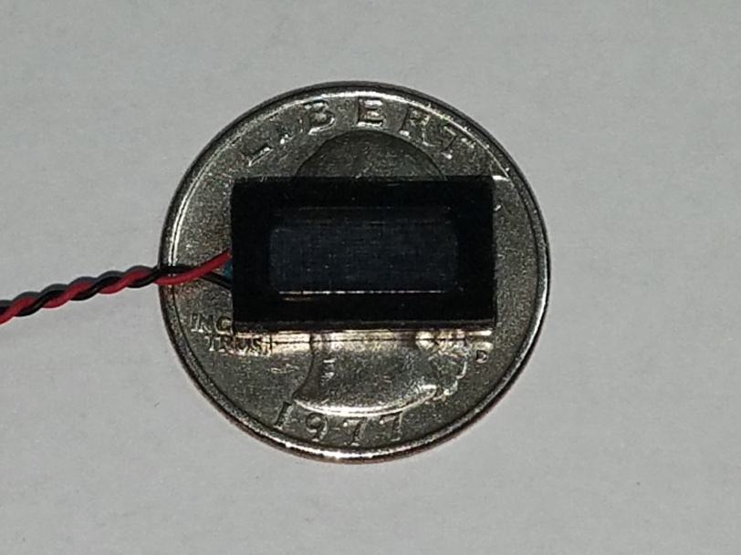
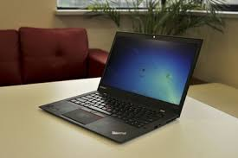
Demo Requirements: 1 - Output a pre-data-encoded 48k sampled wavfile at desired SPLs
2 – MATLAB processing on standard PC/Mac (DSP & Audio Toolboxes)
3 – 48k wavfile recording on “non-PC/Mac” devices incapable of MATLAB execution
You don’t need a large transducer, even a cellphone speaker will suffice.
Transmit
Transducer example
Capture from ONE of the two (stereo) microphones on PC or Mac (don’t use mono on Mac)*
To perform precise assessment, a good external audio capture (e.g., USB mixer with > 20 bits precision) with a known high-quality microphone.
Receiver

Slide 6
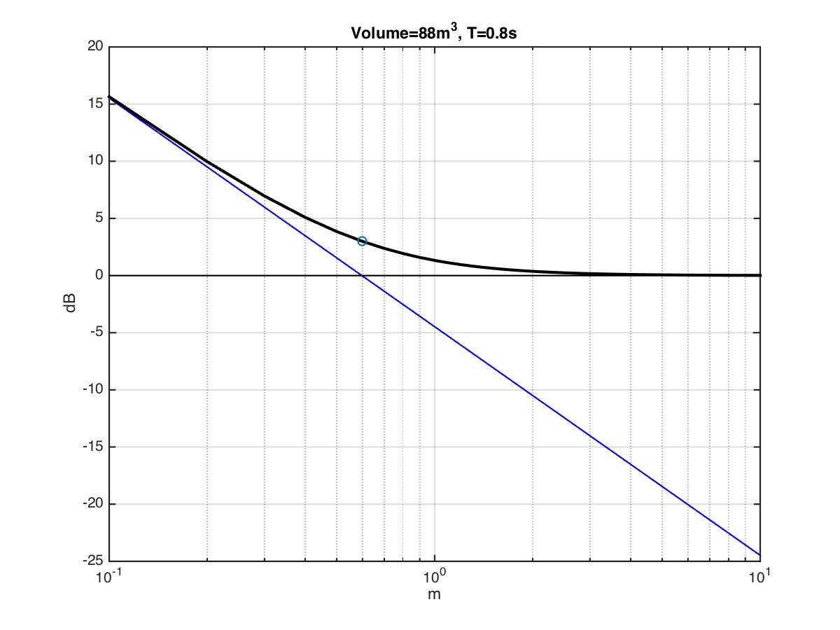
Room Acoustics: Direct / Reverberant Power
RT₆₀ ~ Quiet Rooms: 0.5, Office: 0.4 – 0.7, Homes: 0.9
SPL of Direct and Reverberant sound is equal at 0.6 m / 2.0 ft. (for this RT₆₀ = 0.8 sec room)!
“Self-Noise” == Negative SNR (direct to sum(non-direct)) Reverberant energy dominates!
Total Power
No Reflections
Direct Path Free Space Attenuation
“Diffuse field area” (SPL ~= const)
6 dB
Double Distance
Any distance over ~ 3 feet can be difficult for non-SS receivers requiring: “dominant path power” > “self noise” Test locations far away from sound source for “worse-case reception” conditions.
15 dB at 4 M
1 meter
2 meters
Notes:
Direct sound is spherical wave
Reduction with distance
Reverb equal level
Critical distance: Levels equal
Inside: Good chance
Outside: Reverberant dominates
Vary with f due to directivity and absorption

Slide 7
Typical Conference Room Impulse Responses

Slide 8
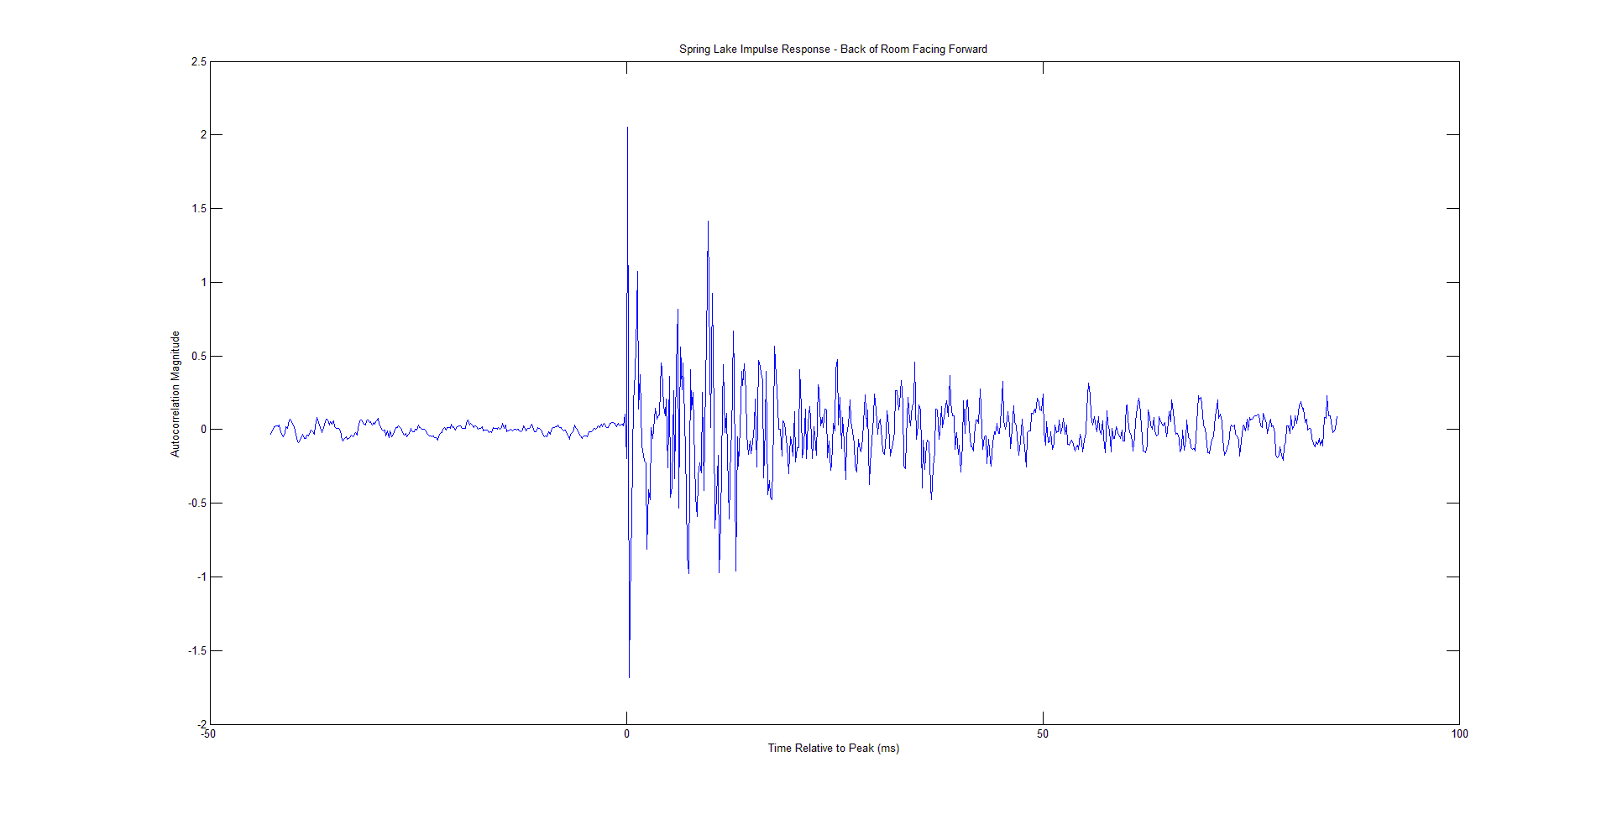
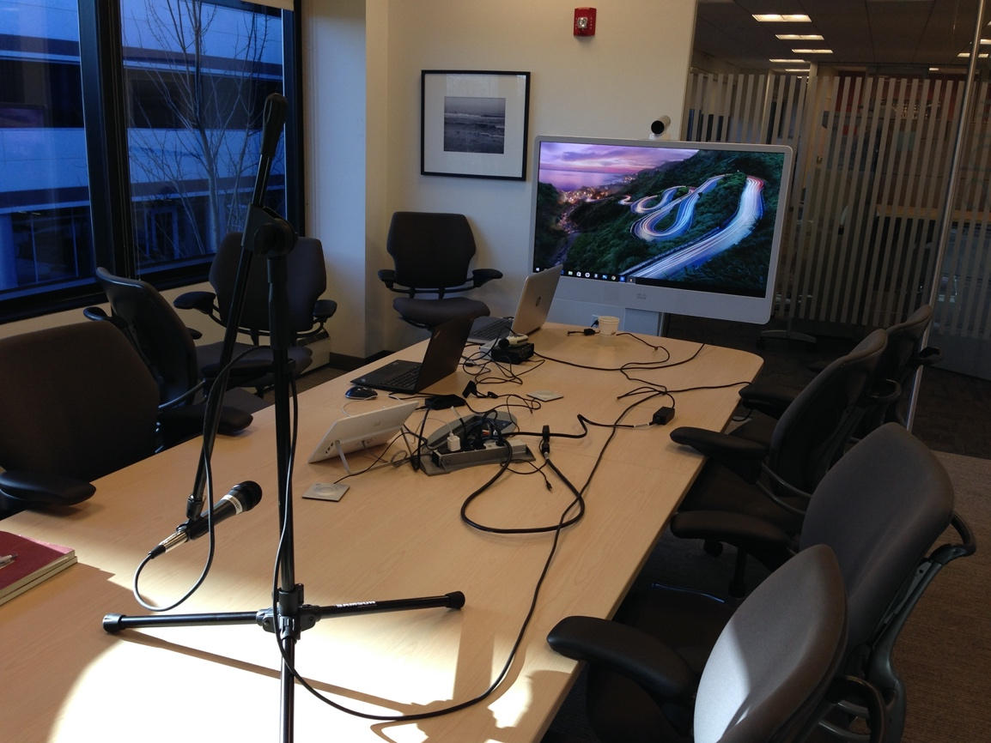
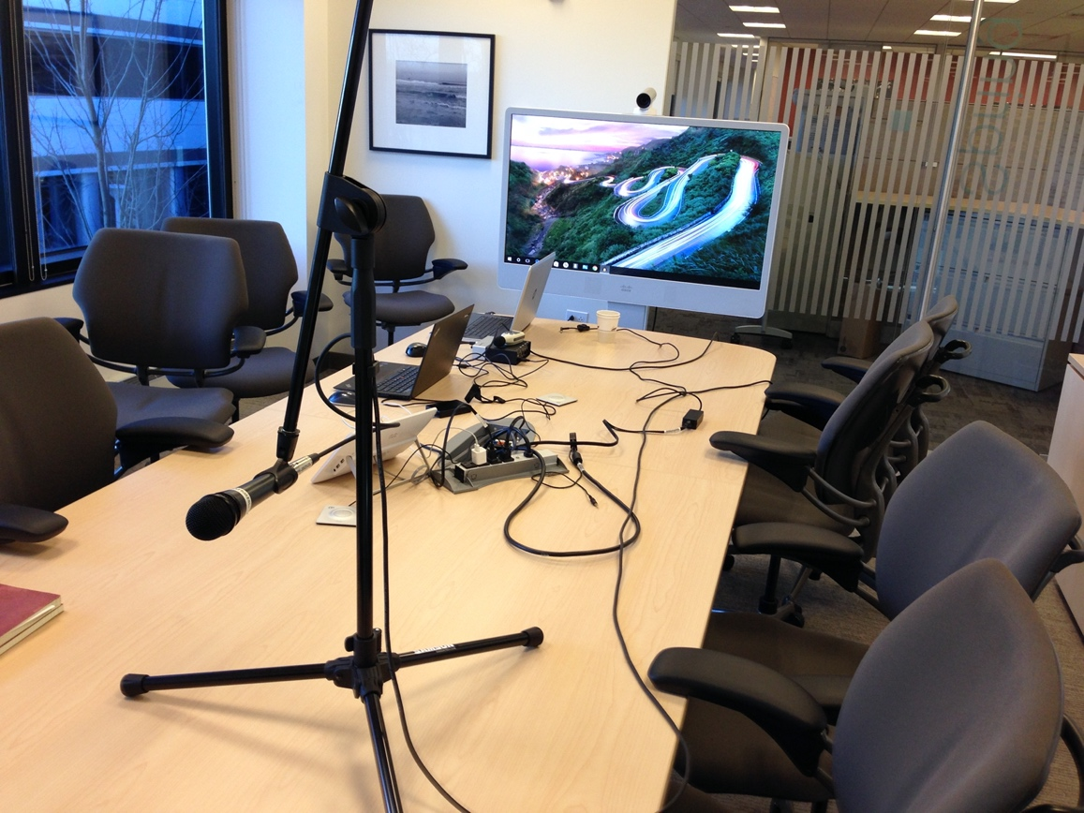
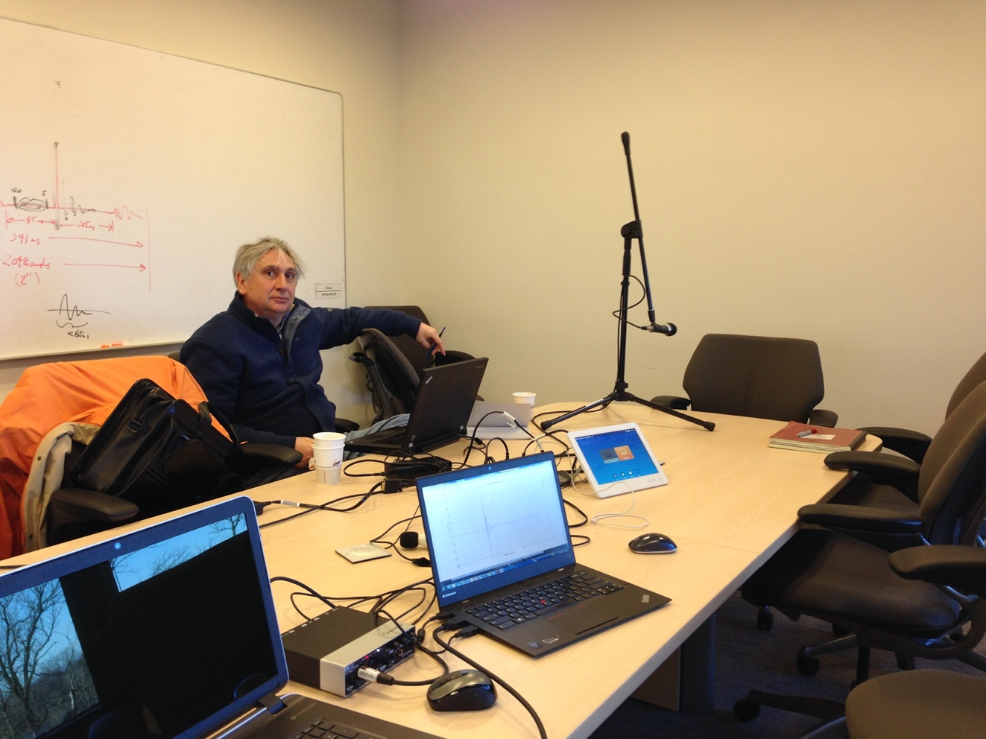
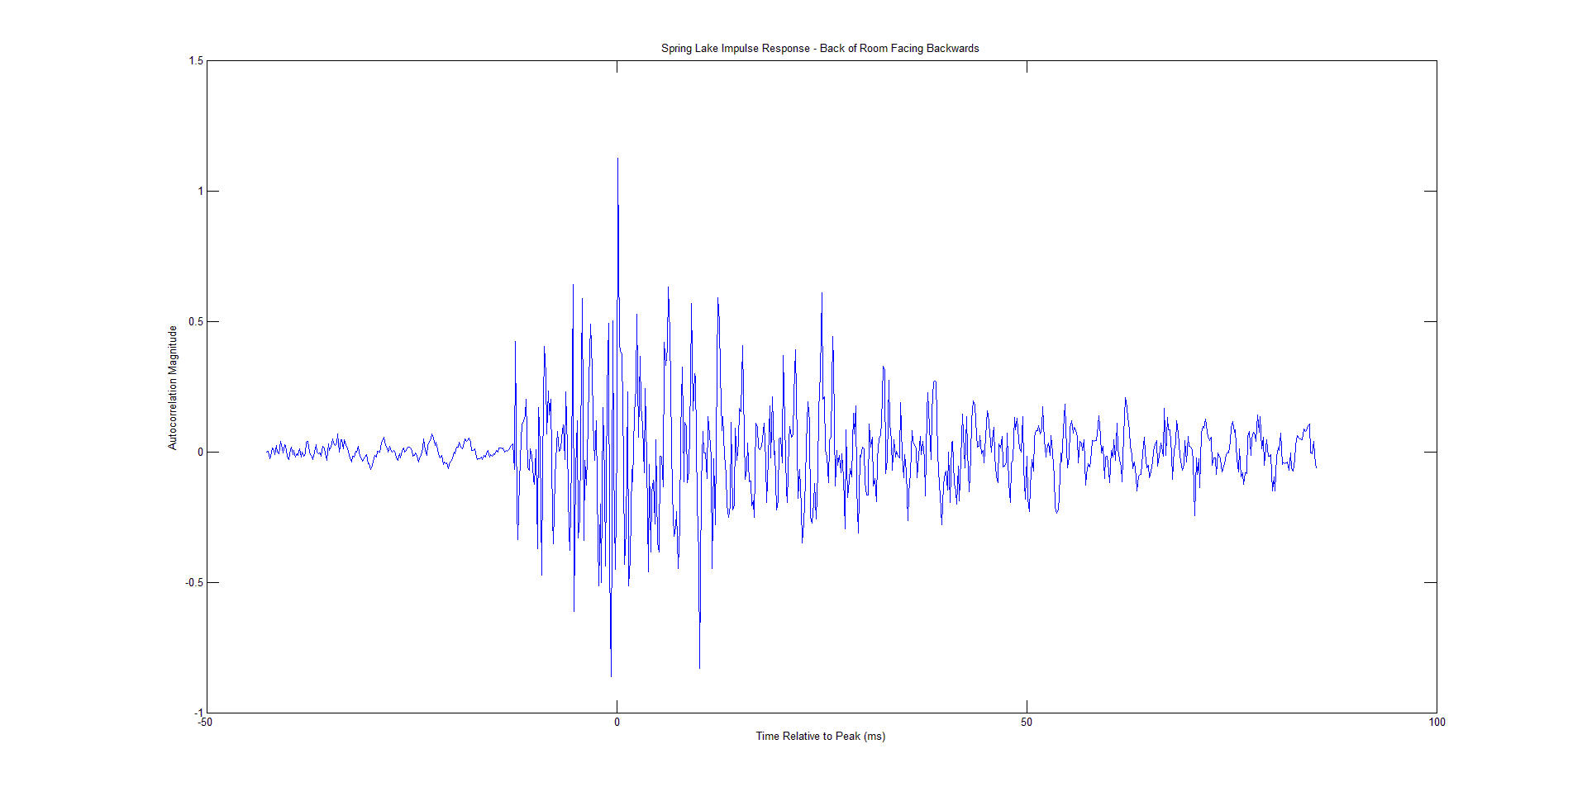
Conference Room Impulse Response
Ultrasound-emitting speaker
Studio (directional) microphone
Direct Path (Line of Sight)
MX300 G2
Mic Facing Forward
Mic Facing Backward
Distance to/from back wall is ~12 ms.
Take Aways:
Dominant signal path may be a major reflection!*
Dominant path to next-most dominant path can have delays of 0 – 20⁺ ms. and still have comparable magnitudes!
Large Reflective Back Wall
Reflection off of back wall (NLOS)
Can measure these RIRs with receiver software provided.

Slide 9
Demo Software Basics

Slide 10
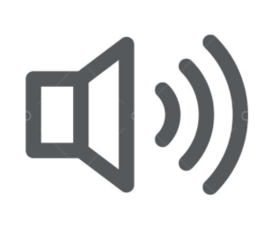

AcousticComms Spread Spectrum Demo Components
Ability to output a 48k wavfile at specified SPL
Two Possible Receiver Scenarios:
Real-time Decode – Using ACSSv2_rtdec.m On a PC/Mac capable of running the MATLAB real-time decoder. or Non-Real-Time Decode (2 step process) – Using ACSSv2_dec.m
Step 1: A record using a device that cannot run the real-time MATLAB decoder – but can produce a 48k wavfile (e.g. smartphone).
Step 2: The 48k wavfile produced in Step 1 is then input to a PC/Mac running the MATLAB non-real-time decoder.
This wavfile has pre-encoded user data in it.*
The data is organized in 31 bit chunks, called “tokens”. The Tokens are labeled (e.g., Token 1, Token 2 ... ).
The token information (the labels and bits) is stored in a MATLAB “matfile” and are used by the decoder to verify correct reception (or not) of the received tokens.
All sent tokens have been verified as unique (no two 31 bits chunks are ever repeated).
* - By providing output wavfiles, no ACSS encoder specifics are divulged.

Slide 11
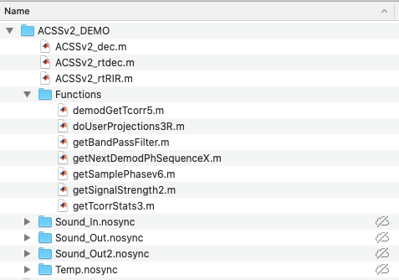
AcousticComms Spread Spectrum Demo Software
Download the entire ACSSv2_DEMO directory (and all subdirectories) to your hard Drive in a directory of your choosing (suggestion is to make a new directory/folder on your system). Download this directory from: https://drive.google.com/drive/folders/1Q0QzIQt_9xE7GXbChYtEGaDAww0Qgg-X?usp=sharing
All MATLAB execution should occur in the directory you downloaded to. The paths to all necessary functions will be added to your MATLAB PATH during m-file execution. There are no environment variables to set up.
The structure should look similar to:
MATLAB executables
Functions used by executables
DATA and TEMP Directories

Slide 12
Wavfile Output Recommendations – 1 of 2
Wavfiles are in subdirectory “Sound_Out2.nosync”
Experiment Number is “123” (need this for later)
Recommended Output Level: 72 dB SPL @ 10 cm
Well below any long-term exposure limit (@25 cm), but usually sufficient for the ACSS signal to be appreciably above the noise (in 19kHz -21kHz band). If this is the case (verify via spectrogram measurement of background noise), this level can be measured via low-cost dBA meter. Since dBA meter has a weighting of approximately 10 dB at 20kHz, a reading of 62 dBA corresponds to 72 dB SPL for the ACSS signal.
If your output device does not have precise level control, you may choose to output any of the following ACSS files which have progressively lower dBoV (number before “dB” is in negative dBoV).
EXP_123_48k_0dB.wav
EXP_123_48k_3dB.wav
EXP_123_48k_6dB.wav
EXP_123_48k_9dB.wav
EXP_123_48k_12dB.wav
EXP_123_48k_15dB.wav
EXP_123_48k_18dB.wav
EXP_123_48k_20dB.wav
EXP_123_48k_22dB.wav
EXP_123_48k_24dB.wav
EXP_123_48k_26dB.wav
EXP_123_48k_28dB.wav
EXP_123_48k_30dB.wav
Full Scale Output (0dBoV)
-6 dBoV Output (~1 bit headroom)
-12 dBoV Output (~2 bit headroom)
... and so on ...
Note: If your output system does not have protection against overdriving the speaker, start measurements using lower amplitude wavfile versions (i.e., ones with higher dBoV in their name) and work upward.

Slide 13
Wavfile Output Recommendations – 2 of 2
Suggested Playout of ACSS (ultrasound): Bookend the un-hearable sound with a hearable sound
Perform the 1 minute ACSS decoder experiments (invoke decoder or recording) somewhere within the two minute emission window
time
2 minutes of ACSS (e.g. EXP_123_48k_XXdB.wav)
1 second of a “hearable sound” (such as Three_near_1500Hz_48k_XXdB.wav)
Three_near_1500Hz_48k_0dB.wav
Three_near_1500Hz_48k_3dB.wav
Three_near_1500Hz_48k_6dB.wav
Three_near_1500Hz_48k_9dB.wav
Three_near_1500Hz_48k_12dB.wav
Three_near_1500Hz_48k_15dB.wav
Three_near_1500Hz_48k_18dB.wav
Three_near_1500Hz_48k_20dB.wav
Three_near_1500Hz_48k_22dB.wav
Three_near_1500Hz_48k_24dB.wav
Three_near_1500Hz_48k_26dB.wav
Three_near_1500Hz_48k_28dB.wav
Three_near_1500Hz_48k_30dB.wav
1 second hearable sounds are in subdirectory “Temp.nosync”
Numbers before “dB” are values in minus dBoV (same as ACSS wavfile output)
In Linux (example): “mplayer Three_near_1500Hz_48k_6dB.wav EXP_123_48k_6dB.wav Three_near_1500Hz_48k_6dB.wav”

Slide 14
Testing the Non-real Time MATLAB ACSS Decoder (ACSSv2_dec.m) and Explanation of Output/Plots

Slide 15
Non-Real-Time ACSS MATLAB decoder (ACSSv2_dec.m) – 1 of 4
The demos in this package only require the entire directory structure of ACSSv2_DEMO and all its subdirectories be copied to the machine running MATLAB. There are no environmental variables to be set up.
MATLAB DSP toolbox is required for all scripts. Additionally the MATLAB Audio toolbox is required for the real-time decoder.
The non-real time decoder requires an input recorded wavfile placed in the “Sound_In.nosync” directory of the form: EXP_XYZ*.wav where “*” is a wildcard to provide flexibility in naming your recorded files and XYZ is the “experiment number” used in the output wavfile name. For example, if the ACSS sound output was from file EXP_123_48k_12dB.wav - you could name your recorded wavfile EXP_123_location_5_conf_room_2.wav. Then put this wavfile in the Sound_In.nosync directory (where the non-real-time encoder expects such files) and run the non-real time decoder.
[If you are running on a PC (not on a Mac) feel free to delete the “.nosync” portions of the subdirectory names.]
First we test the entire package by executing ACSSv2_dec.m using the following wavfiles already in the “Sound_In.nosync” directory: 1) EXP_123_48k_test1.wav (no channel, no reverb, no in-band AWGN noise – perfect transmission and reception) and 2) EXP_789_48k_test2.wav (no channel, no reverb, in-band AWGN at 0 dB – noise and signal power equal)
(See next slide)

Slide 16
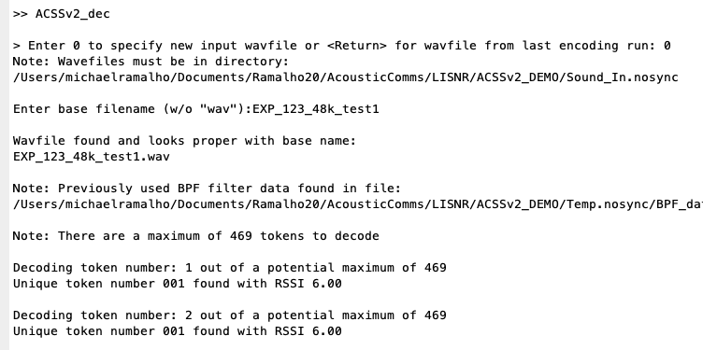
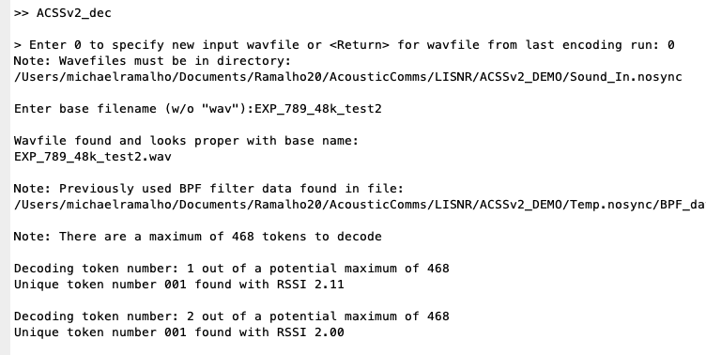
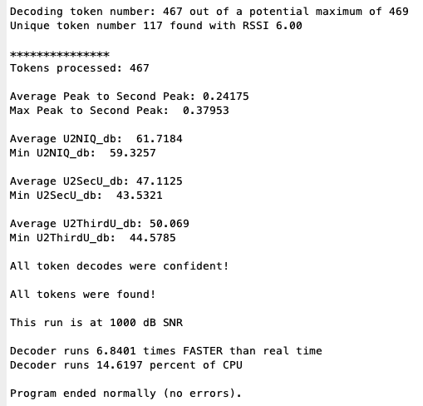
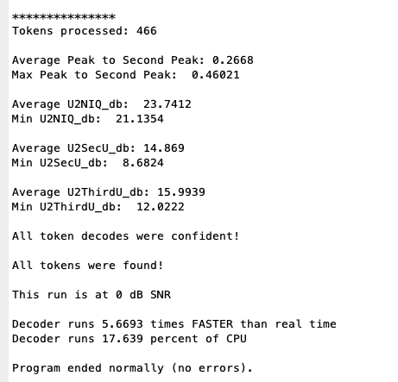
Non-Real-Time ACSS MATLAB decoder (ACSSv2_dec.m) – 2 of 4
Enter decoder script name
Enter “0” for explicit filename
Enter wavfile name without “.wav”
Enter decoder script name
Enter “0” for explicit filename
Enter wavfile name without “.wav”
Your full directory path will be different
Your full directory path will be different
Reverberation Measure
Reverberation Measure (near 6 – no reverb, near 0 – dominant path pwr near diffuse pwr)
Measure of Dominant to Secondary and Tertiary (reverb) paths
Various Signal Quality Metrics
Confidence is 0 (not confident) or 1 (token confident) for every decoded token
Explanation later.
Reminder that TRANSMITTED signal had no noise
Reminder that the TRANSMITTED signal had in-band AWGN noise power equal to the ACSS signal power

Slide 17
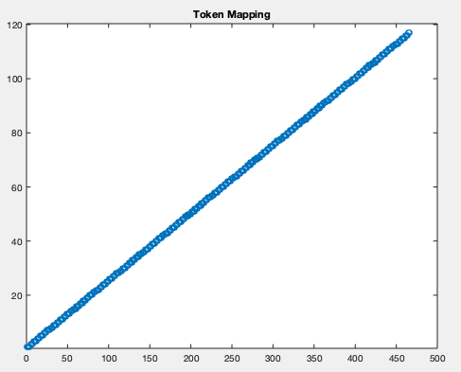
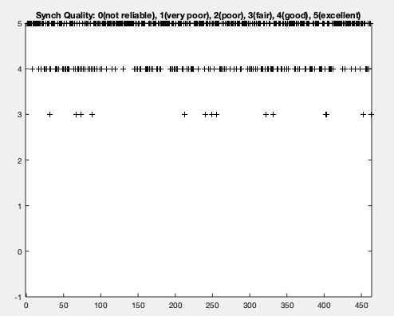
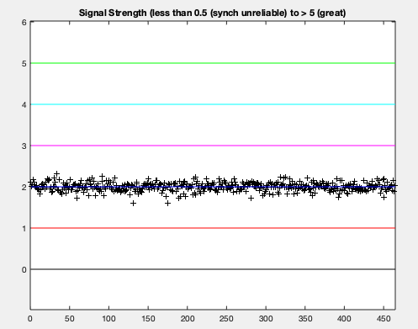
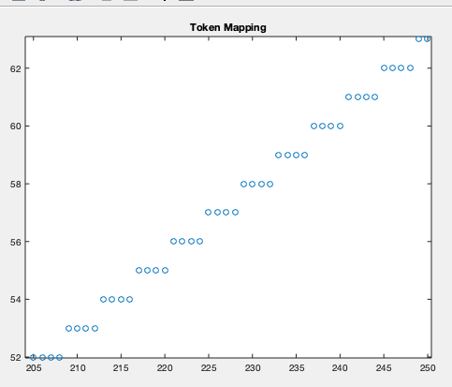
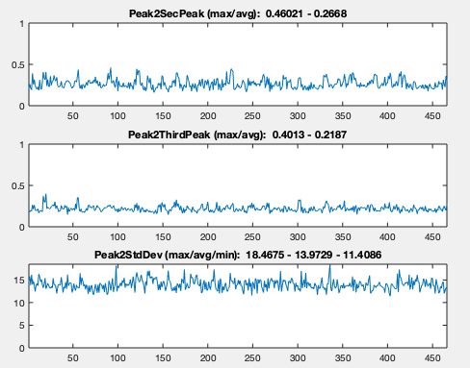
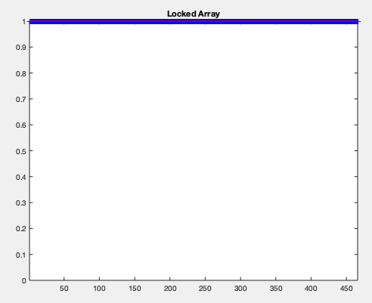
Non-Real-Time ACSS MATLAB decoder (ACSSv2_dec.m) – 3 of 4
Output plots for the no-reverb, but AWGN = 0 dB run (EXP_789_48k_test2.wav received wavfile)
Actually a reverberation strength metric
Token Number Label
Near perfect signal (<<critical distance, > 0 dB SNR)
“NFC distance” POS Region
“Contactless distance” POS
Good synch, even though ACSS signal power is equal to noise.
Room Proximity
High Reverb or SNR approaching - 6 dB
Token decode attempt number
Use Case Examples
Each TRANSMITTED token is repeated 4x at the encoder (configurable at encoder)
When receiver distance is beyond the critical distance, the usual case is that one or more acoustic paths are nearly equal. The Peak-to-Second peak will be near one when the next most dominant path is almost the same power as the dominant path.
If a token decode results in all reception metrics passing, a confidence of 1 is assigned to the token. If not, then 0 is assigned. This plot shows all decoded tokens were confident.
Note: When a token is “not found” in a given decode, -1 is plotted for that decode.

Slide 18
Non-Real-Time ACSS MATLAB decoder (ACSSv2_dec.m) – 4 of 4
The ACSS decoders provided (ACSSv2_rtdec.m and ACSSv2_dec.m) use signal metrics not explained here (U2SecU_db, U2NIQ_db and U2ThirdU_db) and if they are above their respective thresholds a confidence value of 1 is assigned.
When these metrics are above their thresholds it is virtually impossible (probabilistically speaking) that the token is in error. If the reception passes this test (and confidence = 1 for token), the token is forwarded to the upper layers.
However, these thresholds are set conservatively – marginal decodes may have been assigned confidence = 0 even though the token decode is correct.
The ACSS decoders “cheat” in that they know all the tokens in the transmit file – knowledge that a real implementation does not have. The decoders actually decode marginal token receptions (those that do not pass the thresholds) and see if the correct token has been decoded despite missing the metrics (and thus being marked confidence = 0).
If any token decode matches a sent token it is said to be “found”; otherwise the token decode is said to be “not found”.
It is very important that a “not found” token (a decode that is known not to have been sent) NEVER be assigned as confident ... because it means that a “bad token data” would have been forwarded to the upper layers.
When 1 or more tokens are not confident, a check is performed to see if any “not found” tokens were incorrectly declared “confident”. If all “not found” tokens were also declared “not confident” a “good news” message is output.
As an aside, a real implementation would have error checks (e.g., CRC) as proper transmission hygiene at upper layers.

Slide 19
Running the Real-Time MATLAB ACSS Decoder

Slide 20
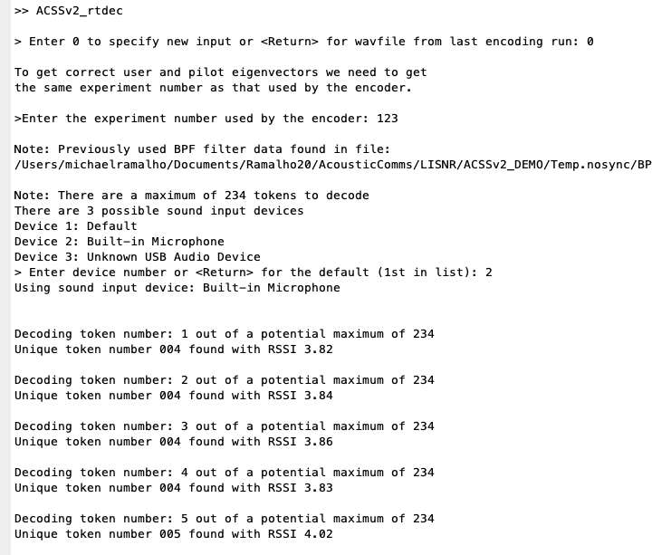
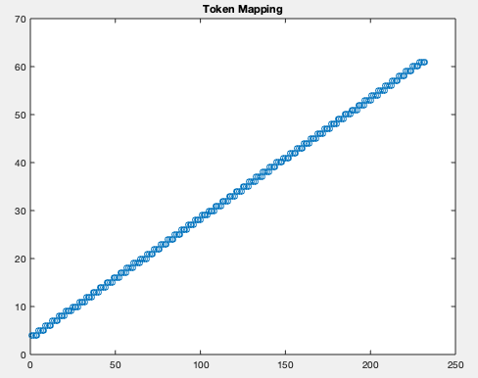
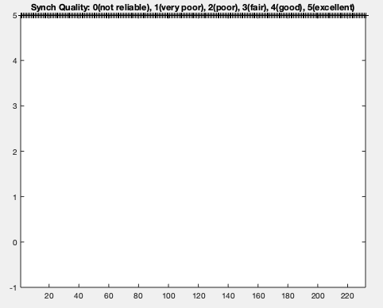
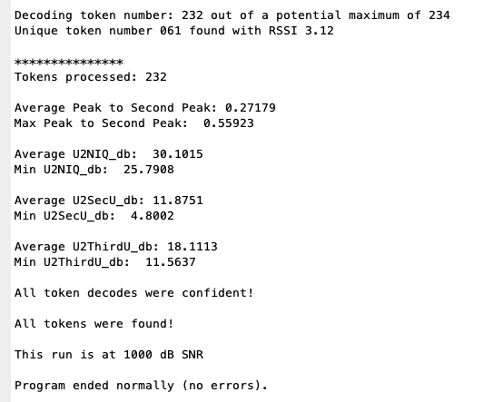
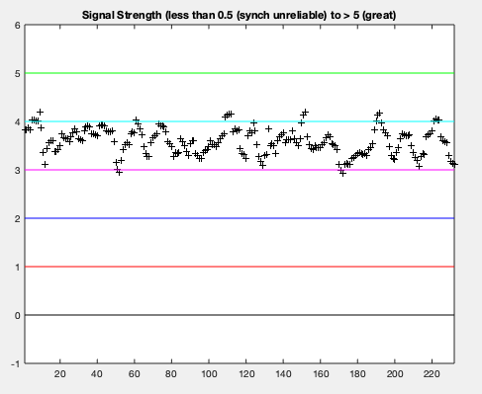
Real-Time ACSS MATLAB decoder (ACSSv2_rtdec.m)
Instructions:
Enter decoder script name
Enter “0”
Enter Experiment Number “123”
Set up sound output per prior instructions (using a filename beginning with “EXP_123”).
Execute ACSSv2_rtdec script shortly after hearable sound. The script performs decodes for ~1 minute.
Your full directory path will be different
Choose the device number you want to use
Your available audio input devices will be listed here
Reverberation Measure (~3 inches from speaker to microphone on this run)
Perfect Token Mapping
Perfect Synchronization Metrics
Reverberation Metric consistent with < critical distance, but not “NFC close”
Metrics as described earlier (see plots for reception details)
NOTE: Speaker-to-mic distance was ~ 4 inches during this run.

Slide 21
Running the Non-Real-Time MATLAB ACSS Decoder

Slide 22
Non-Real-Time ACSS MATLAB decoder (ACSSv2_dec.m)
Instructions:
Set up sound output per prior instructions (using a filename beginning with “EXP_123”).
With the receiver microphone placed where you want it, record a 48k sampled mono wavfile.
This recording should be about one minute long.
Note that this recording may be made on a specialized device such as a smartphone or tablet.
Name this wavfile with the beginning characters of of the filename being “EXP_123” and ending characters of “.wav”. An acceptable filename would be: “EXP_123_conf_room_2_location_5.wav”
Place the recording in the “Sound_In.nosync” subdirectory.
Run the ACSSv2_dec MATLAB script exactly as the testing examples provided earlier – except using the filename of the recording you just made.
Look at your plots to assess your reception statistics.
Repeat using new recordings for as many experiments/locations you wish to study.

Slide 23
BONUS: Running the Real-Time MATLAB ACSS Room Impulse Response Generator

Slide 24
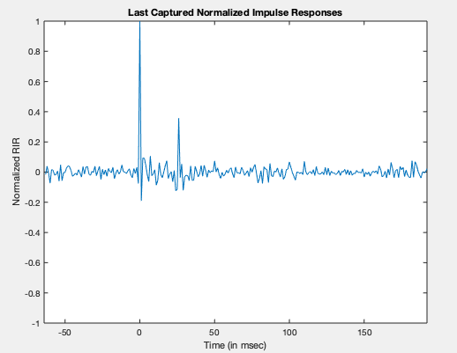
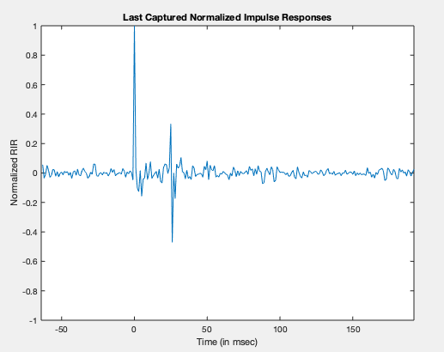
ACSS Room Impulse Responses – 1 of 2
Room Impulse Response (RIR)
When the ACSSv2 signal does NOT contain user data, but only the pilot/synchronization channel, the periodic autocorrelation of the proprietary sequences used provide a smoothed, time-aliased version of the room impulse response (from speaker to microphone). Smoothed because it only uses ~1500 Hz to sound the channel (smoothing ~1ms) and time-aliased because the sequence is only 256 ms long (e.g., the energy at delay = 257 ms adds to the energy at delay = 1 ms).
These are just examples. I have measured peaks at 40 ms. that were 60+% of the peak RIR. You may measure your “challenging locations”.
26 ms. pos peak (35.81% of peak)
26 ms. neg peak (47.14% of peak)

Slide 25
ACSS Room Impulse Responses – 2 of 2
Room Impulse Response (RIR)
Instructions:
Set up sound output per prior instructions, but this time using a filenames beginning with “EXP_234” (which are “pilot only” sound outputs).
Run the ACSSv2_rtRIR MATLAB script exactly as you did the ACSSv2_rtdec MATLAB script previously. That is:
(As before) choose “0” to enter an experiment number.
Be sure to use “234” as the experiment number (because you output “EXP_234_*.wav”), and ...
(As before) choose the audio input device you wish to use.
About once per second a new plot should appear that has four estimates of the RIR (as there are about four cycles of a 256 ms. signal in a second). If the speaker, the microphone and room occupants are stationary then the four plots should overplot themselves (as the RIR is non-time varying). If the mic/speaker/occupants move – then you have a time varying RIR – and the RIR plots will not overplot themselves as a result.
Experiment by moving speaker and microphone locations to find “challenging locations” for your existing system. Challenging locations might be where secondary RIR peaks occur at 5 ms (Zoom), 10 ms (Chirp.io), 15 ms (deprecated Cisco proximity), 20 ms (Lisnr), etc. Then try your existing system at those locations.

Slide 26
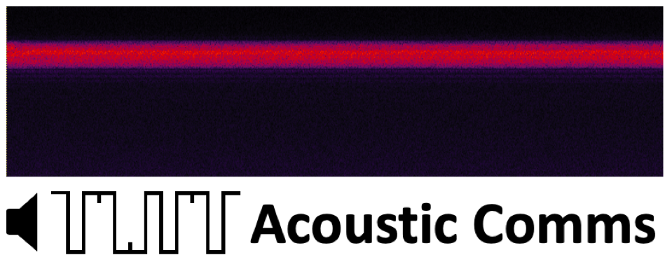
Spectrogram of AcousticComms Spread Spectrum (ACSS) Proximity Signal ~ 1500 Hz BW
http://acousticcomms.webhop.info/
Information on why Spread Spectrum is superior to tone techniques

